Slide 1

Leadership Emergence
Derek Lukacsko
Organizational Behavior (Spring 2019) with Professor Hafenbrädl

Slide 2
What is Leadership?
formal authority role (Weber 1947)

Slide 3
What is Leadership?
formal authority role (Weber 1947)
f(personality, skills, attributes, leader-like actions) (Wayne et al. 1997; Walumbwa et al. 2008)
designated / formal (1. 2.)

Slide 4
What is Leadership?
formal authority role (Weber 1947)
f(personality, skills, attributes, leader-like actions) (Wayne et al. 1997; Walumbwa et al. 2008)
social construction (DeRue et al. 2010, Hoggs et al. 2003)
Leadership as series of interlocking acts of leading and following. Shift away from people as leaders to leading and following process (DeRue 2011).
designated / formal (1. 2.)

Slide 5
What is Leadership?
formal authority role (Weber 1947)
f(personality, skills, attributes, leader-like actions) (Wayne et al. 1997; Walumbwa et al. 2008)
social construction (DeRue et al. 2010, Hoggs et al. 2003)
Leadership as series of interlocking acts of leading and following. Shift away from people as leaders to leading and following process (DeRue 2011).
4. network patterns of interpersonal perception (DeRue et al. 2015)
designated / formal (1. 2.)
emergent / informal (2. 3. 4.)

Slide 6
Research Question What determines leadership emergence?
structural and individual mechanisms
Notes:
A: the researcher

Slide 7
Replication Study
Gianluca Carnabuci, Cécile Emery, David Brinberg (2018) Emergent Leadership Structures in Informal Groups: A Dynamic, Cognitively Informed Network Model. Organization Science

Slide 8
(Carnabuci et al. 2018)
Grounding theory*: People hold an internalized knowledge structure for leadership relations which they activate when trying to make sense of their relationships.
Tested theory: People adjust their leadership attributions to balance their cognitive schema.
Empirical test: Network asymmetry
Conclusion: Evidence for the emergence of informal leadership networks in groups that feature no formally designated leaders or authority hierarchies
Notes:
* Implicit value proposal

Slide 9
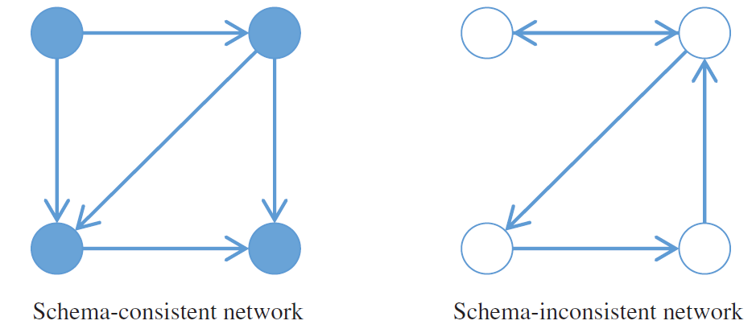
(Carnabuci et al. 2018)
Grounding Theory: People hold an internalized knowledge structure for leadership relations which they activate when trying to make sense of their relationships.
Experiment 1: Cognitive recall task (n1 = 31, t1 = 7.94, n2 = 20, t2 = 10.35, p=0.013)

Slide 10
(Carnabuci et al. 2018)
Tested Theory: People hold an internalized knowledge structure for leadership relations which they activate when trying to make sense of their relationships.
Experiment 2: Computer-based leadership attribution (n1 = 36, n2 = 37, 9.4% change, 51.4% in expected direction, p<0.01)

Slide 11
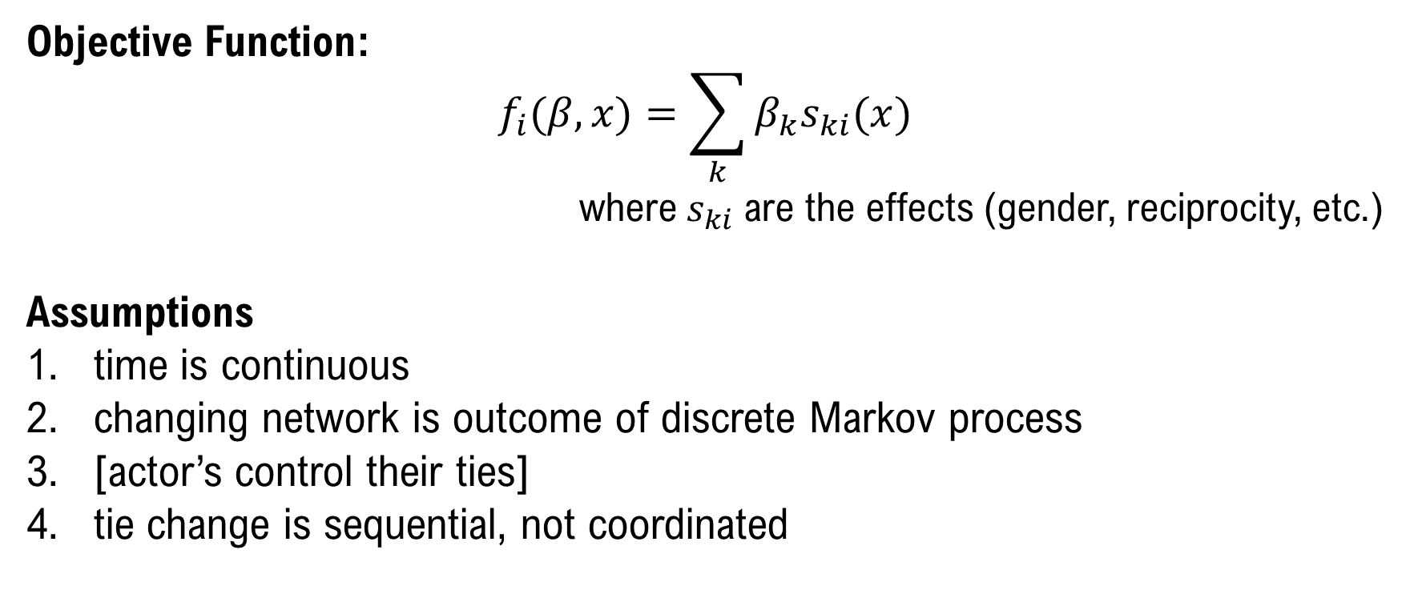
Stochastic-Actor Oriented Model used to determine what affects tie creation
Objective Function:
$$f_{i}(β,x)=\sum_{k}{{β_{k}s}_{ki}(x)}$$
where${ s}_{ki}$ are the effects (gender, reciprocity, etc.)
Assumptions
time is continuous
changing network is outcome of discrete Markov process
[actor’s control their ties]
tie change is sequential, not coordinated

Slide 12
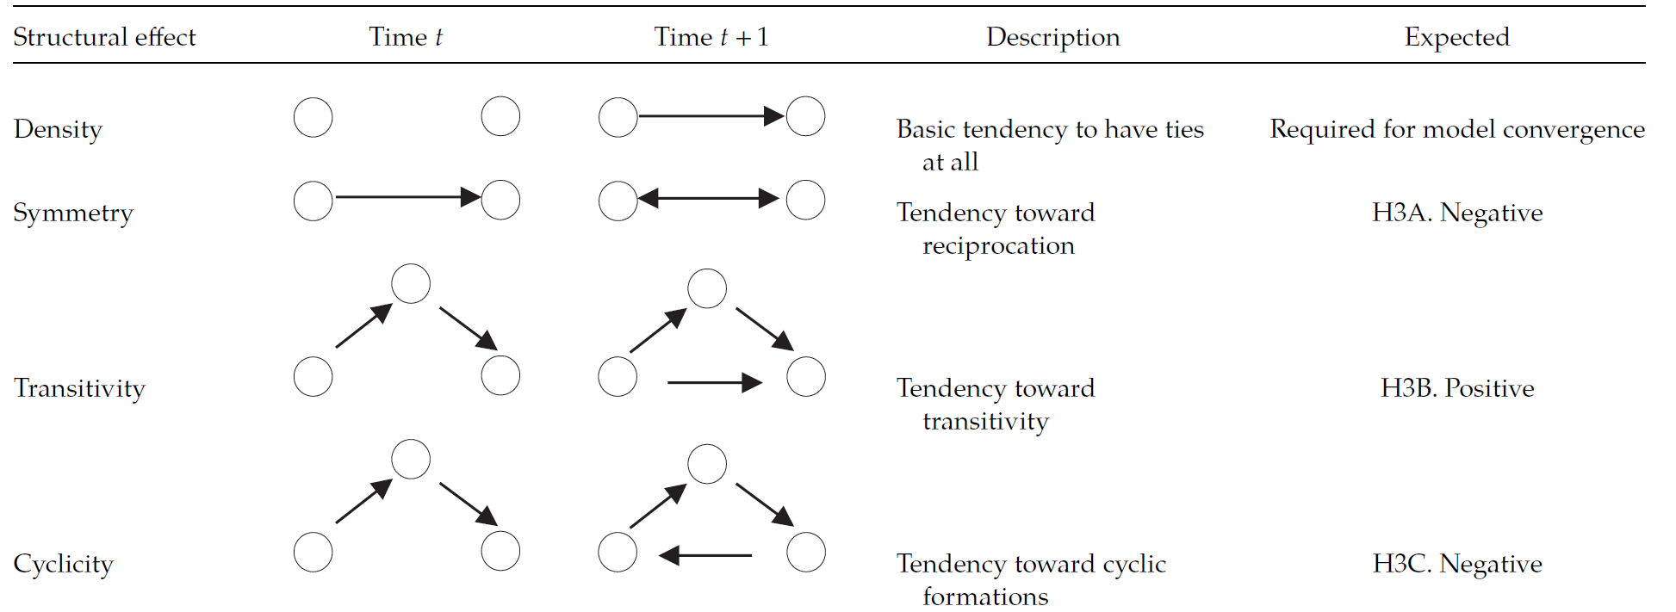
(Carnabuci et al. 2018)
Empirical test: network asymmetry

Slide 13
Study Design - hypotheses
H1: Missing endogenous factor – result a function of study design
Step 1: Falsify theory of cognitive linear order schema through robust replication of Carnabuci et al. 2018
Q: Does this explain how leaders emerge?
H2: Missing exogenous factor – result a function of quality
Step 2: Incorporate three measures of quality individual level variables
Q: Does quality attenuate the effect of reciprocity?
H3: Theory Contribution - Leadership emergence depends on some unique combination of constructed status and observed quality (Gould 2002; Podolny 2010)
Step 3: Incorporate dyad-level in and out-degree asymmetries
Q: …
Theory Test
(Carnabuci et al. 2018)

Slide 14
Study Design - case comparison
 | (Carnabuci et al. 2018) | Theory Test
Sample | U.S. undergraduate students | French soldiers
Setting | exchange semester | army training
Sections | 3 | 11
Time periods | 4/3/3 | 7
Collection interval | 1/mo * 3 | 2/mo * 3
Identification | 1. Who do you regard as a leader? 2. … a task leader? 3. … a relational leader? | 1. Who do you regard as a leader?
Individual controls | gender, self-esteem, self-monitoring | gender, self-confidence
Dyad controls | t=1 friendship, interaction frequency | t=1 friendship, interaction frequency
Method | SAOM | SAOM

Slide 15

Study Design – sample setting
If cognitive linear balance schema are used to determine leadership perception, it should be observed in the army since “leadership and the military are practically inseparable” (Wong et al. 2003).
Leadership emergence occurs within groups without designated leaders. Though guided by instructors, trainees are equal in formal role status and collectively socialized to army values; they engage in identical activities and spend the majority of the time together. The sample affords a highly controlled environment to conduct a conservative test on the emergence of informal leadership through cognitive linear balance schema.

Slide 16
H1: Missing endogenous factor
Alternative explanations: (1) evaluation wasn’t representative of experience due to excessive unobserved heterogeneity in group embeddedness, (2) cognitive schema were affected between collection periods, (3) leadership was not important to participants.

Slide 17
H1: Missing endogenous factor
Alternative explanations: (1) evaluation wasn’t representative of experience due to excessive unobserved heterogeneity in group embeddedness, (2) cognitive schema were affected between collection periods, (3) leadership was not important to participants.
Robust sample → H1A: The probability that a group member, i, will regard (stop regarding) group member j as his/her leader decreases (increases) if j regards i as his/her leader.
Expected: reject

Slide 18
H1: Missing endogenous factor
Alternative explanations: (1) evaluation wasn’t representative of experience due to excessive unobserved heterogeneity in group embeddedness, (2) cognitive schema were affected between collection periods, (3) leadership was not important to participants.
Robust sample → H1A: The probability that a group member, i, will regard (stop regarding) group member j as his/her leader decreases (increases) if j regards i as his/her leader.
Expected: reject
Increased time periods + decreased time interval → H1B: The effect of leadership (followership) role enaction change is more salient in t+1 than t+2.
Expected: reject

Slide 19
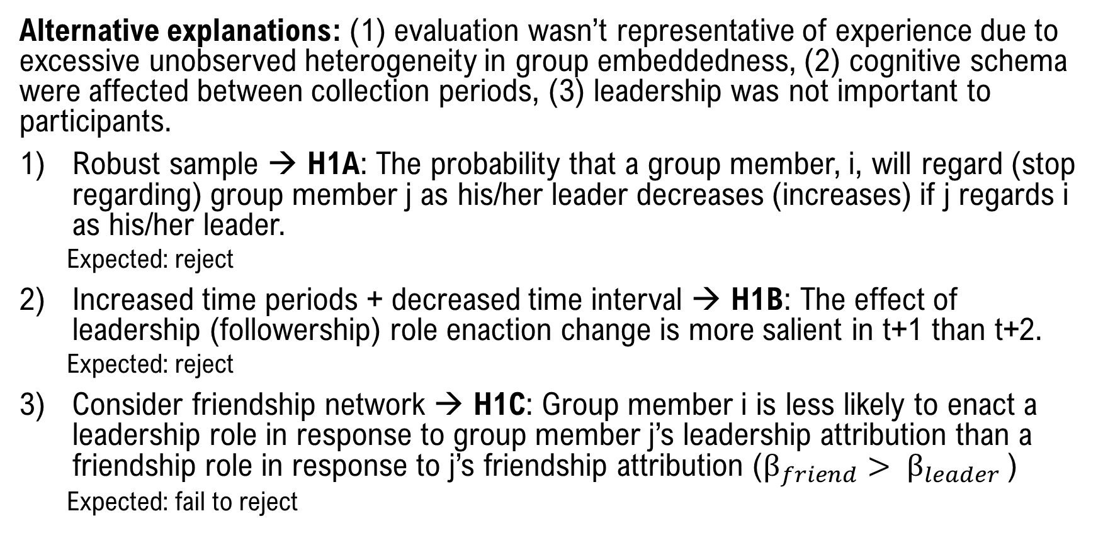
H1: Missing endogenous factor
Alternative explanations: (1) evaluation wasn’t representative of experience due to excessive unobserved heterogeneity in group embeddedness, (2) cognitive schema were affected between collection periods, (3) leadership was not important to participants.
Robust sample → H1A: The probability that a group member, i, will regard (stop regarding) group member j as his/her leader decreases (increases) if j regards i as his/her leader.
Expected: reject
Increased time periods + decreased time interval → H1B: The effect of leadership (followership) role enaction change is more salient in t+1 than t+2.
Expected: reject
Consider friendship network → H1C: Group member i is less likely to enact a leadership role in response to group member j’s leadership attribution than a friendship role in response to j’s friendship attribution ($β_{friend}> β_{leader}$)
Expected: fail to reject

Slide 20
H1 → H2
External assessment is necessary for evaluating outcomes in non-hierarchal team settings (Carson 2007), an element missing from the largely analytical work on emergent leadership which considers emergence a purely endogenous process. Given that symmetry is a significant structural driver of leadership emergence (if H1 is supported), leadership may emerge through either the tendency to attribute leadership to those that achieve valued outcomes (H2) or through both the tendency to reciprocate leadership attributions and the tendency to attribute leadership to high quality others (H3, e.g. Gould 2002).

Slide 21
H2: Missing exogenous factor
We consider three separate measures of exogenous quality—leadership, followership, and performance—as inter-subjectively desirable node-level outcomes and predictors of leadership emergence in addition to structural symmetry using SAOMs (H2). A random subset of 3-4 instructors are selected every two weeks to rate each trainee on these three measures.

Slide 22
H2: Missing exogenous factor
We consider three separate measures of exogenous quality—leadership, followership, and performance—as inter-subjectively desirable node-level outcomes and predictors of leadership emergence in addition to structural symmetry using SAOMs (H2). A random subset of 3-4 instructors are selected every two weeks to rate each trainee on these three measures.
H2A: Emergent leaderships is positively related to demonstrating leadership ability, followership ability, or performing well. Quality has a positive effect on forming ties
Expected: fail to reject
H2B: Quality attenuates the effect of reciprocity.
H2C: Over time, measures of quality decrease in effect as cumulative perception and expectations converge to the group norm.

Slide 23
Potential Implications
Person-situation debate (empirics): stimuli should be sampled from organism’s natural environment so as to be representative of population which it’s adapted which we wish to generalize from (Brunswick 1956)
Problem of Embeddedness (theory): atomization has not been eliminated, merely transferred to the dyadic or higher level of analysis (Granovetter 1985)

